Slide 1
REGULATION OF HORMONE SECRETION
Sri Wahyuni
FK UNIMAL

Slide 2
If we are talking about hormones, we always have to think abaout :
The name
The glands/ the cells
The target cells
Function in the target cells
The stimulaters
The inhibitors
Feed back mechanism

Slide 3
Regulation of hormone secretion normally prevents overproduction or underproduction any of the hormone
Hormon secretion is regulated by:
Signal from the nervous system
Chemical chances in the blood
Others/hormones

Slide 4
Hormones are secreted by endocrine glands when there is a need for them, that is, for their effects on their target organs
When a hormone brings about its effects, the stimulus is reversed, and secretion of the hormone decreases until the stimulus reoccurs.
In any hormonal negative feedback mechanism, information about the effects of the hormone is “fed back” to the gland, which then decreases its secretion of the hormone. This is why the mechanism is called “negative”: The effects of the hormone reverse the stimulus and decrease the secretion of the hormone.
The secretion of many other hormones is regulated in a similar way.

Slide 5
The hormones of the anterior pituitary gland are secreted in response to releasing hormones (also called releasing factors) secreted by the hypothalamus.
Growth hormone, for example, is secreted in response to growth hormone–releasing hormone (GHRH) from the hypothalamus.
As growth hormone exerts its effects, the secretion of GHRH decreases, which in turn decreases the secretion of growth hormone. This is another type of negative feedback mechanism

Slide 6
THE PITUITARY GLAND

Slide 7
Anterior pituitary gland

Slide 8
POSTERIOR PITUITARY GLAND

Slide 9
The Thyroid Gland

Slide 10
The Parathyroid Glands

Slide 12
The Pancreas

Slide 13
Adrenal medulla

Slide 15
Adrenal Cortex

Slide 16
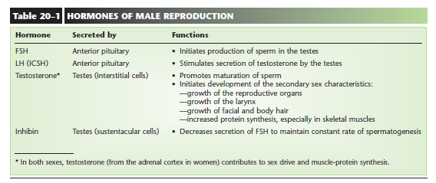
Hormones of Male Reproduction

Slide 17
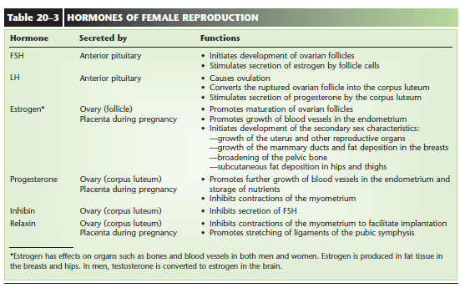
Hormones of Female Reproduction

